Slide 1


SAP BTP Training
Cloud Foundry Training

Slide 2

DISCLAIMER
The training content and delivery of this presentation is confidential, and cannot be recorded, or copied and distributed to any third party, without the written consent of Anubhav Trainings

Slide 3

LEARNING OBJECTIVES
SAP BTP CAPM Development
Add UI Module to mta.yaml
App Router Concept
Implementing App router
Deploy and Test

Slide 4
Process Of Implementation
Create a New backing service instance for XSUAA
While creating this instance we need to pass our Role Configuration (JSON) = xs-security.json
Documentation for making xs-security file
https://help.sap.com/viewer/4505d0bdaf4948449b7f7379d24d0f0d/2.0.03/en-US/6d3ed64092f748cbac691abc5fe52985.html
We need to bind our app with this backing service
If we use Java, we need to add a security module (Spring) to restrict access to end points
https://github.com/SAP/cloud-security-xsuaa-integration
Deploy and Test our app
{
"xsappname": "07springodata",
"tenant-mode": "dedicated",
"scopes": [{
"name": "$XSAPPNAME.AnubhavDisplay",
"description": "To Display vendor data"
},
{
"name": "$XSAPPNAME.AnubhavEdit",
"description": "To Create new vendor data"
}
],
"role-templates": [{
"name": "Viewer",
"description": "View, Vendor Details",
"scope-references": [
"$XSAPPNAME.AnubhavDisplay"
]
},
{
"name": "Editor",
"description": "Edit and Create new Vendor Details",
"scope-references": [
"$XSAPPNAME.AnubhavEdit"
]
}
]
}
www.anubhavtrainings.com

Slide 5
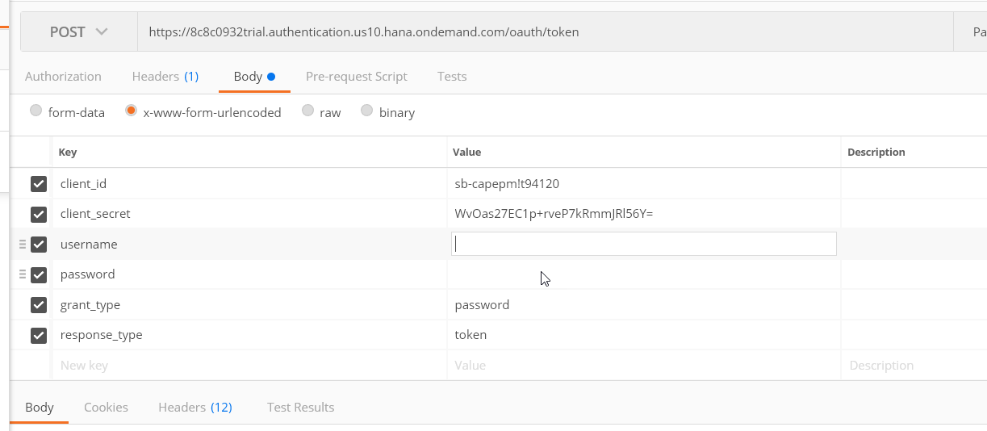
Obtaining JWT Token from XSUAA
Create a POST call to XSUAA service to obtain JWT token
Type: POST
URL : <url from CF>/oauth/token
Body – x-www-url-encoded
(examples)
client_id - <get from cf>
client_secret - <get from cf>
username – <pass your CF email id>
password – <your CF password>
grant_type – password
response_type – token
2. Call your Service - https://07springodata-smart-wolverine-rk.cfapps.eu10.hana.ondemand.com/anubhav.svc
Type: GET
Headers –
Authorization : Bearer <token which we obtain in last step>
Content-Type : application/json
www.anubhavtrainings.com

Slide 6



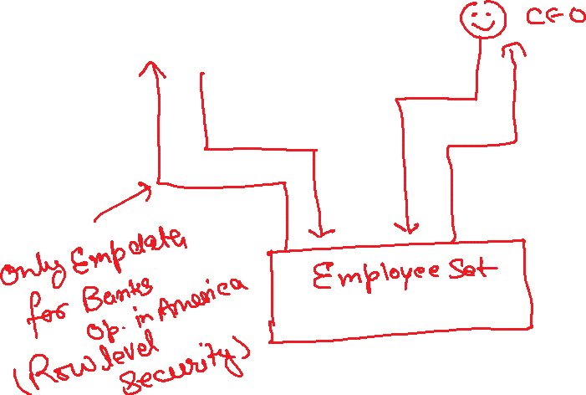







Authorizations Control
www.anubhavtrainings.com

Slide 7
Security – Authentication/Authorization
Create a entry for cloud foundry managed service of type xsuaa in mta.yaml file
Add that as a require resource into the system
Create a xs-security.json file with the required configuration, Roles, Role Template, Attribute
Go to xs-app.json file, add the authentication method as route And also add the "authenticationType": "xsuaa",
Install the dependencies for passport, @sap/xsenv, @sap/xssec
Add the configuration for security in package.json inside cds section
"uaa": {
"kind": "xsuaa"
}
Add authentication strategy with optional dev profile so that we can configure local test users
Make sure our resources are protected, CatalogService.cds, go and add authentication force and then authorization control for entity (Row level security)
@(requires: 'authenticated-user')
@(restrict:[
{
grant: ['READ'],
to: 'Viewer',
where: 'bankName = $user.BankName'
},
{
grant: ['WRITE'],
to: 'Admin'
}
])
www.anubhavtrainings.com

Slide 8
Expose APIs - Secure our data to internet
SAP Cloud Connector
Internet
Intranet
mys4hanaserver.company.com
8021
1
4
On-premise
BPC,BW,ECC,S/4
SAP BTP
BAS
2
Secure by SSH
SAP Cloud Connector
3
What is cloud connector?
On-premise connectivity
How to build a Fiori App on BAS using On-premise?
https://help.sap.com/viewer/cca91383641e40ffbe03bdc78f00f681/Cloud/en-US/e54cc8fbbb571014beb5caaf6aa31280.html
www.anubhavtrainings.com

Slide 9
If I already have a functionality in my core, how can I reuse?
Pre-requisite- Create OData Services on top of your ABAP code/ BAPIs, Workflows, BOPF, CDS, BADIs, Exits
Recommend – ABAP on HANA (CDS based OData Services) + UI5 and OData Training (SEGW based Free style services) + Third Party (.NET, legacy, Java Based portal – REST Services)
SAP Standard – SAP Delivers lots of ERP Functionality, SAP Started delivering read-to-use out-of-box APIs – SOAP, ODataV2, ODataV4
https://api.sap.com
SAP Business API HUB – Central place for all the offered APIs for integration purpose.
Difference between SOAP and OData
https://www.youtube.com/watch?v=v_xPlRumdbE
Server access for S/4HANA for your learning on demand
server@anubhavtrainings.com
Cost 2500 INR per month per user / 40 USD
Latest S/4HANA service to build CDS Views, Fiori Apps, Integrations
www.anubhavtrainings.com

Slide 10
Title
www.anubhavtrainings.com

Slide 11
Title
www.anubhavtrainings.com

Slide 12
Title
www.anubhavtrainings.com

Slide 13
Title
www.anubhavtrainings.com

Slide 14

Summarize
LET’S SUMMARISE!

Slide 15

Summarize
End of Day 15

Slide 17


We’re committed to empower you to be
#FutureReady
through powerful training solutions.
We build the workforce of the future.
250+
Corporate Clients
30,000+
Learners Trained
25000+
Learners Placed
FREE WEBINARS
Sign up for free webinars with industry experts every fortnight!
Enroll Now!
Contact us today!
https://anubhavtrainings.com

